Slide 1

AI Recruiter – Shortlist a Suitable candidate for specific Job Role
Team : Code Legion
Submitted By :
Ayush Saxena (Team Leader)
Denish Vaghasia
Bhavyesh Bherwani
Krunal Thumar

Slide 2
What is AI?
AI is an “umbrella term” for a branch of computer science focused on creating machines capable of thinking and learning. Based on their experiences, AIs learn to make better decisions in the
It is also a branch of computer science that deals with the simulation of intelligence behaviour in computers.

Slide 3
Recruitment Process
Recruitment is the process of searching of a prospective employees and stimulating and encouraging to apply for a job.
Recruitment is the process to discover the sources of manpower to meet the requirement of staffing schedule and to employ effective for attracting that manpower in adequate number to facilitate effective selection of an efficient working force.

Slide 4
How AI is going to transform recruitment?
Artificial Intelligence for recruitment is the next generation of software intended to improve or automate parts of the talent acquisition.
AI can be used in recruitment for the following:
Initial screening of resume
Scheduling interview with the help of chat bot
Analyse the result if the candidate would fit into the given role

Slide 5
Purpose
Our purpose is to increase the efficiency of the recruiting and reduce the time that is taken by the recruiter to minimal and speed up the parts of recruiting through automation so that the companies can find the best talent for their job and can increase the recruiting chances by 50% or more.

Slide 6
Existing Problem
52% of talent acquisition leaders say that the most difficult part of their job is to shortlist the right candidate and 3% of candidates never hear back from a company after one touchpoint. On the flip side, it’s a challenge for employers to communicate well with all their candidates. For high volume recruiting, this would require communicating with thousands of candidates, in addition to a recruiter’s normal screening functions and other duties. Artificial Intelligence enabled software bots can definitely provide a solution for this problem.

Slide 7
Proposed Solution
When the candidate will submit his/her resume, our artificial intelligence induced chatbot will screen the resume and will look for the skills required for the job and if the candidate is eligible for the job the bot will ask the candidate some general questions and the bot will identify the skills and personality traits through conversation and will schedule interview with the company.

Slide 8
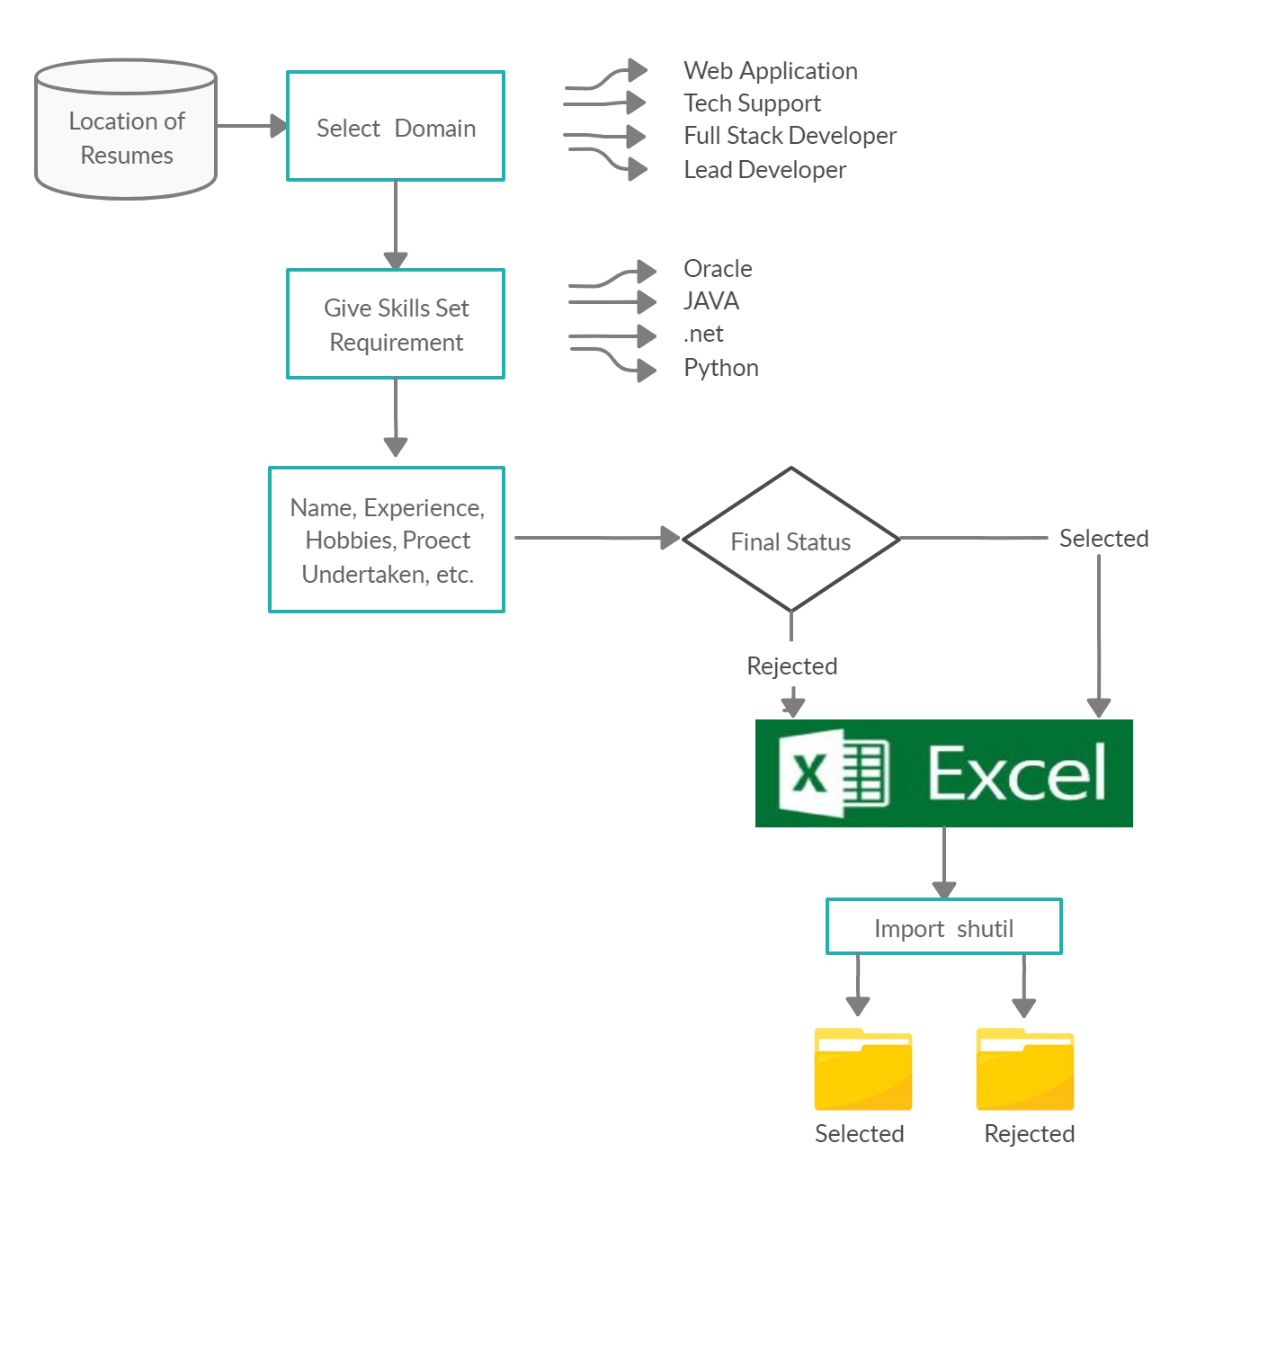
Block Diagram for Sorting Resume

Slide 9
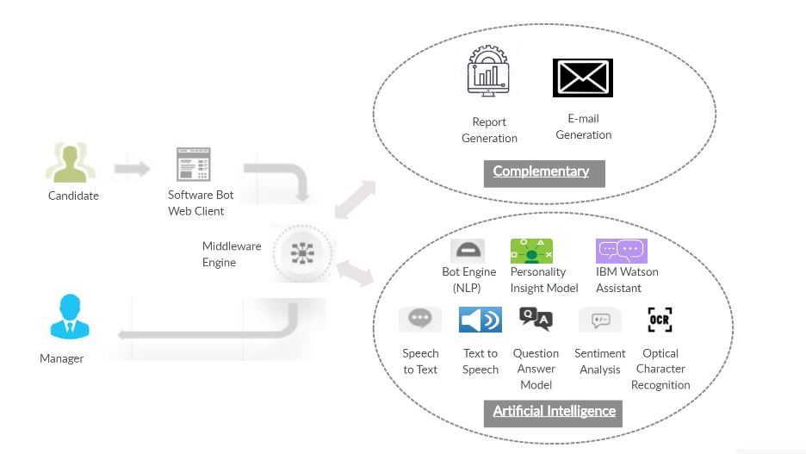
Architectural Flow

Slide 10
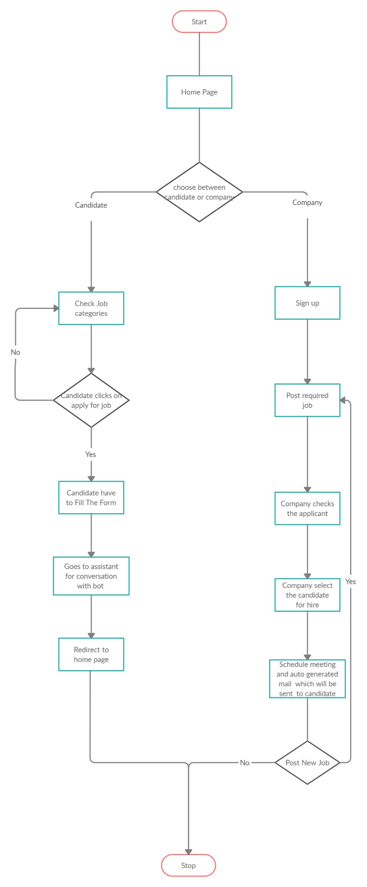
Flowchart for Website
This is the flowchart of our website which shows the overview of both the candidate as well as the company.

Slide 11
Technology Stack
Frontend
HTML5
CSS3
JavaScript
Bootstrap
Backend
Python3 (Backend Framework - Django)
Node red
Cloudant
MySQL

Slide 12
Result
Using our website, the company can save an ample amount of money and time, which they have to give from screening the resume to scheduling the candidate by giving them service 24x7.
Screening the resume.
AI chat bot for analysing skills and personality traits.
Bridge between the candidate and the company.

Slide 13
Advantages
As the recruiting can take up to 23 hours for screening and scheduling for the interview by the HR, AI induced recruiting app bot can screen and schedule the interview without consuming hefty amount of time.
The recruiting chat bot can screen the resume and select the candidates based on their skill without needing the human to check it.
Using AI for recruiting can reduce the cost of screening and turn over up to 75% and 35% respectively.

Slide 14
Conclusion
So, we can conclude that the chatbot can screen the resume and analyze skills and personality traits through conversation using NLP and shortlist the candidate for the interview. By using AI recruiting chat bot the company as well as candidate can save money and time and the turn over of the company can reduce up to 35%.

Slide 15
Future Scope
The AI recruiting chatbot is going to have huge scope in future, as a human cannot consult every applicant and check their skill in a short time. Using the AI recruiting chatbot can remove the menial tasks done by the human by screening the resumes to scheduling the interview with the company.

Slide 16
Thank You

